Slide 1
Summarizing Buyer Behavior in Excel

Slide 2
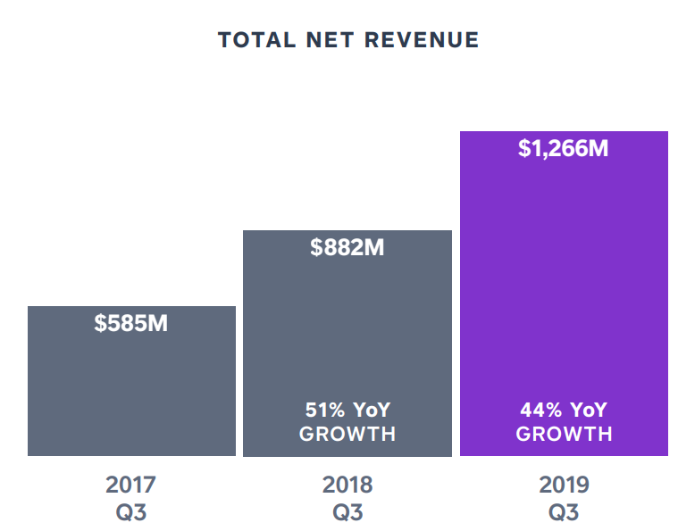
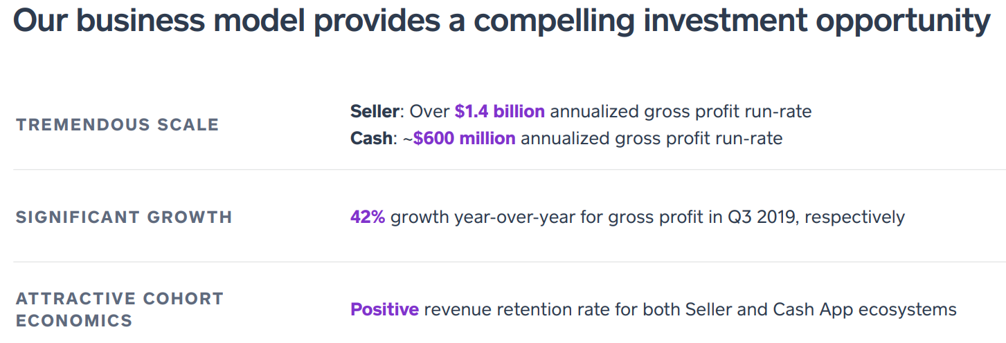
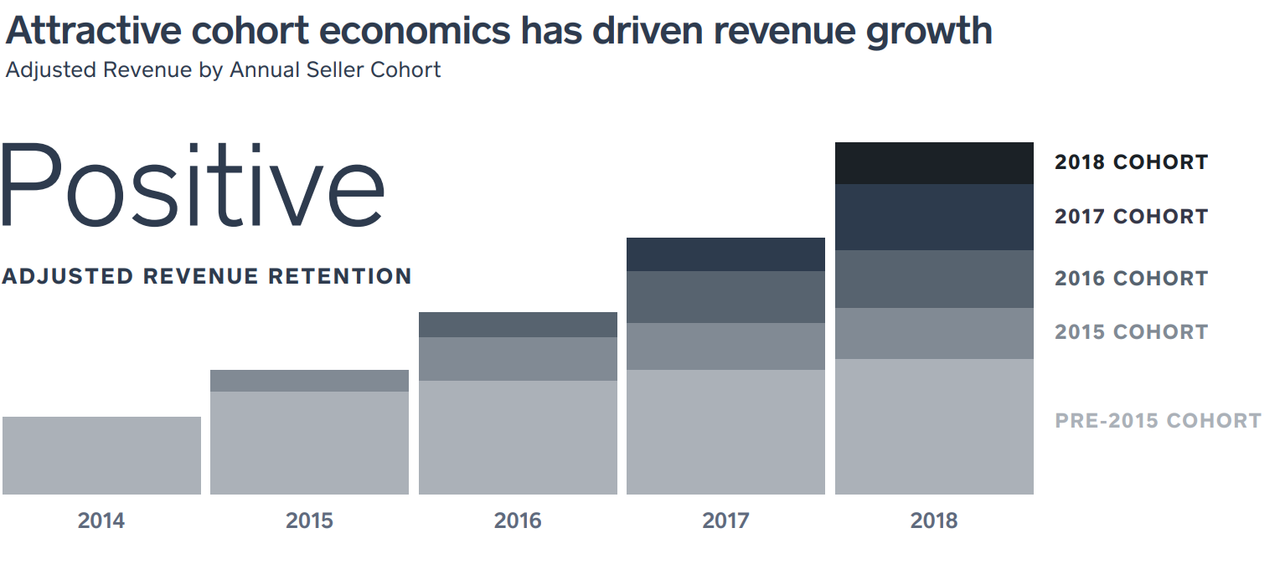
Context
Customer centricity: need to measure and manage customer value
CLV is important, but it requires a statistical model
Valuable to have auditable performance measures
Square investor presentation (Nov 2019):

Slide 3


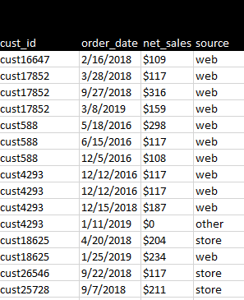


Context
Most organizations:
Clickstream
Social media
Demographics
Survey data
Transaction log
Me:

Slide 4
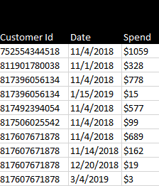

Goals for the next two lectures
Raw transaction log
KPI’s
Excel calculations
Understand “what and why” behind these KPI’s
Learn how to measure unit economic performance
Learn how to mess with transaction logs
Get better with Excel: Pivot Tables, offset(), histograms, plotting, …
I will use the same deck for the next two lectures

Slide 5

What are the KPI’s?
What we will calculate “from scratch”:
Monthly sales over time
Total customers acquired
Customer acquisition cost (CAC)
Distribution of spend per purchase
Initial versus repeat sales volume
Initial versus repeat average order value (AOV)
Sales and AOV by source
First-purchase profitability
Cohorted sales (the “C3”)
Revenue retention curves
Cumulative spend per customer
Distribution of total spend by customer
Customer concentration (“Pareto”) chart
What they summarize:
Growth
Unit costs
Unit profitability
Retention
Heterogeneity (customers, time)

Slide 6
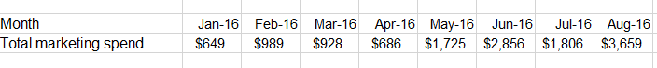
Input data: what do we need?
(only required for cuts by source)
1. Complete transaction log
2. Marketing spend data
3. Margin data
Spend → variable profits
We will use a real transaction log:
Real high-growth “bricks and clicks” startup
$’s scaled, dates shifted
Data is here.

Slide 7
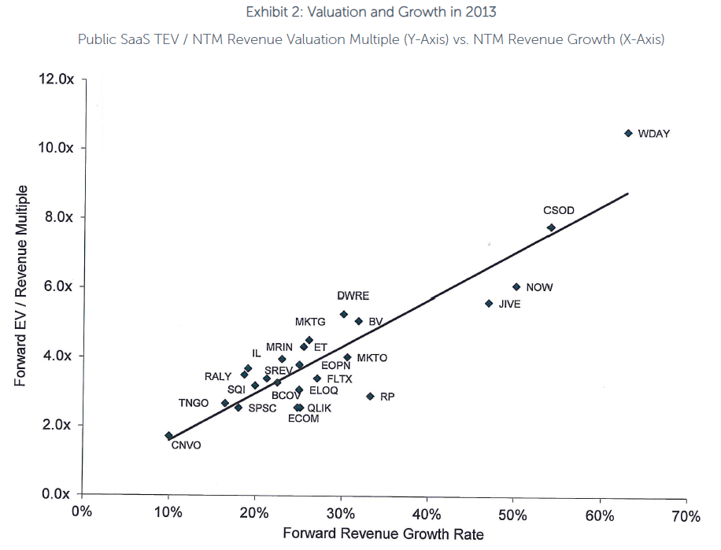
1. Total monthly sales
What: total sales across all customers each month
Why: most standard, commonly-used growth metric (and it matters!)
SaaS Investors: Mind the Valuation GAP (2019):
Square (again):

Slide 8
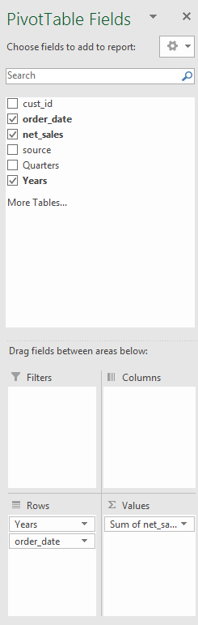
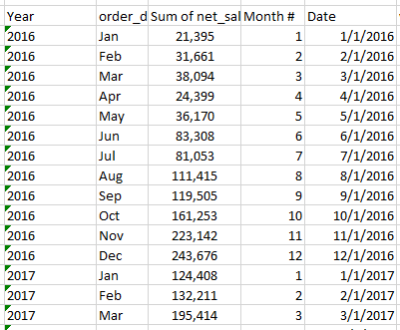
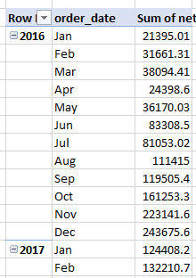
1. Total monthly sales in Excel
Pivot Table:
Rows=months,
cols=sum(sales)

Slide 9
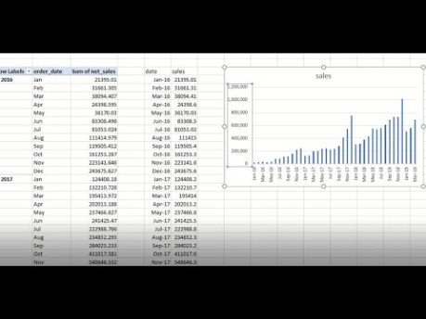
1. Total monthly sales in Excel

Slide 10
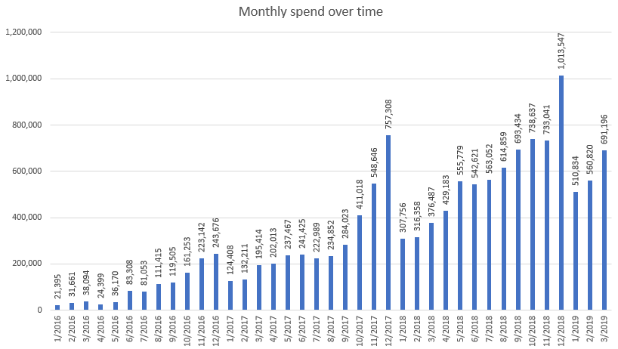
1. Total monthly sales in Excel
What does this show us?

Slide 11
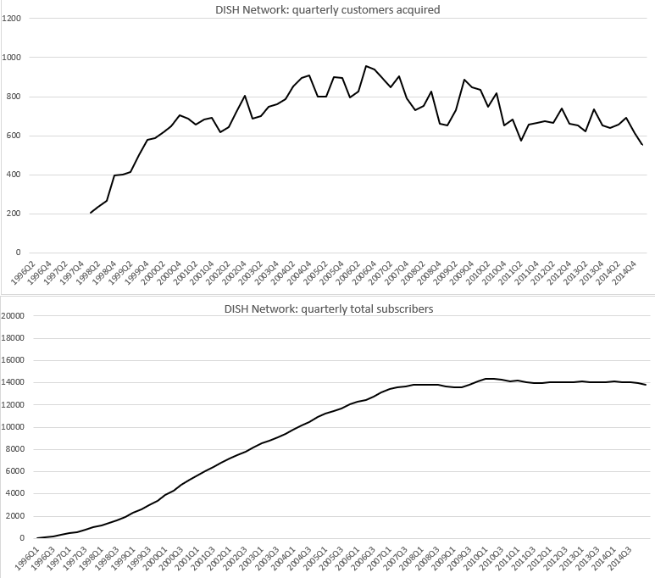
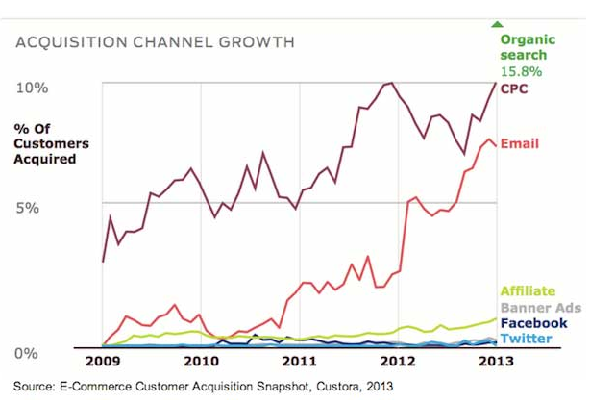
2. Monthly customer acquisitions
What: total first-time buyers each month
Why: explains how growth is coming about (new users? Existing users? …)

Slide 12
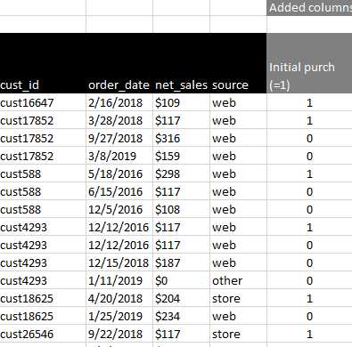
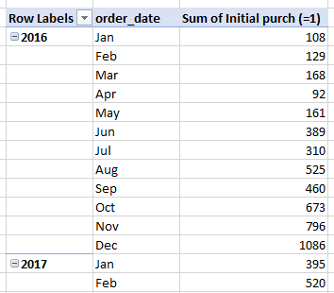
2. Monthly customer acquisitions in Excel
Identify acquisitions
Sort by customer and date
Aggregate acquisitions by month

Slide 13
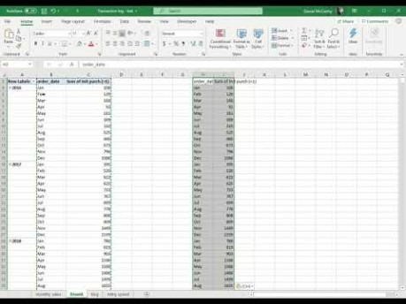
2. Monthly customer acquisitions in Excel

Slide 14
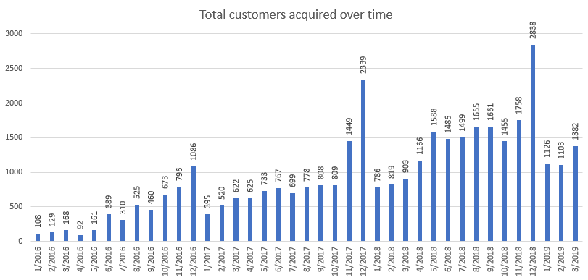
2. Monthly customer acquisitions in Excel
What does this tell us?

Slide 15
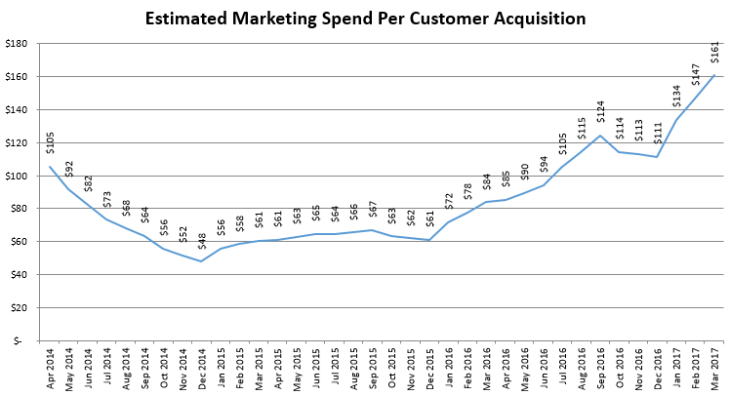
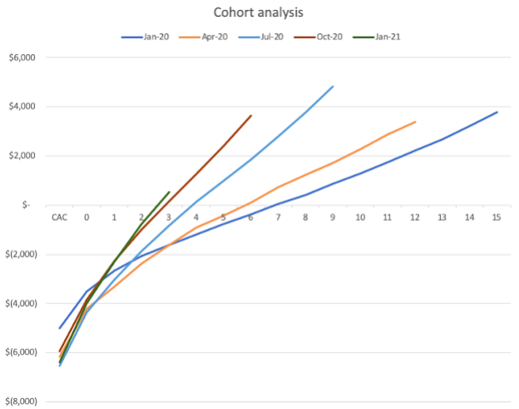
3. Customer acquisition cost (CAC)
What: amount spent per newly acquired customer over time
Why: Key driver of unit economics (remember, E(CLV)=E(PAV)-CAC)
My Blue Apron analysis (link):
From “Cohort analysis” (highly recommended):

Slide 16
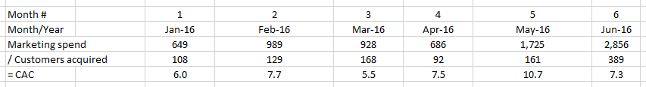
3. Customer acquisition cost (CAC)

Slide 17
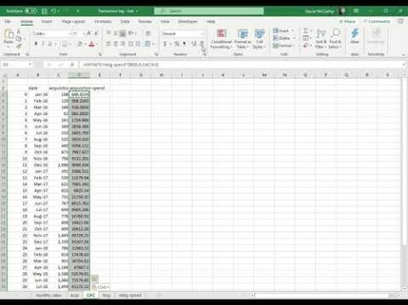
3. Customer acquisition cost (CAC)
Obtaining and plotting CAC:

Slide 18
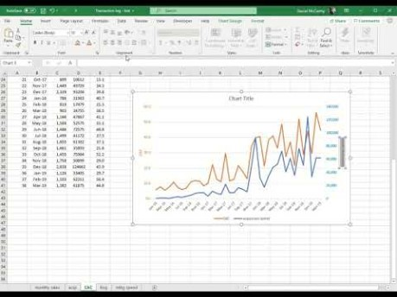
3. Customer acquisition cost (CAC)
Plotting CAC against gross customers acquired:

Slide 19
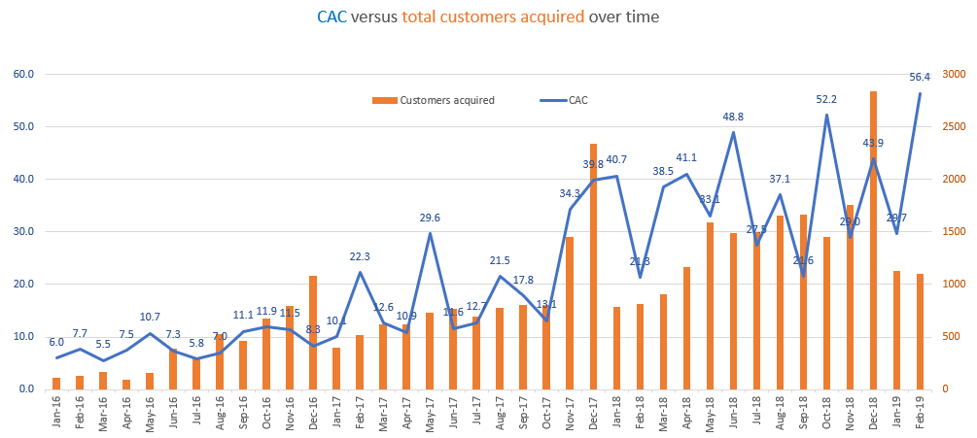
3. Customer acquisition cost (CAC)
What does this tell us?

Slide 20

4. Distribution of spend per purchase
What: histogram of all spends in transaction log
Why: better understand how heterogeneous customer spending is

Slide 21
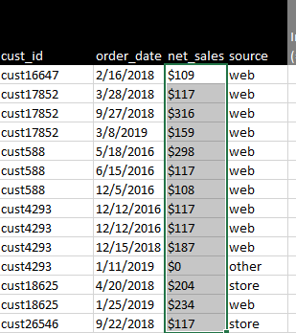
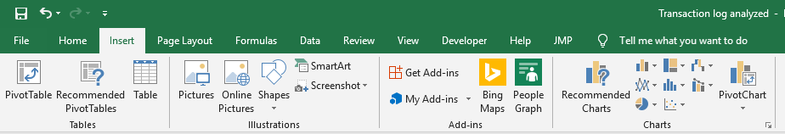
4. Distribution of spend per purchase in Excel
Highlight spends, then click on histogram:
Change bin width and overflow bin:

Slide 22
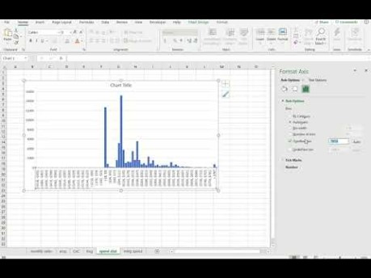
4. Distribution of spend per purchase in Excel

Slide 23
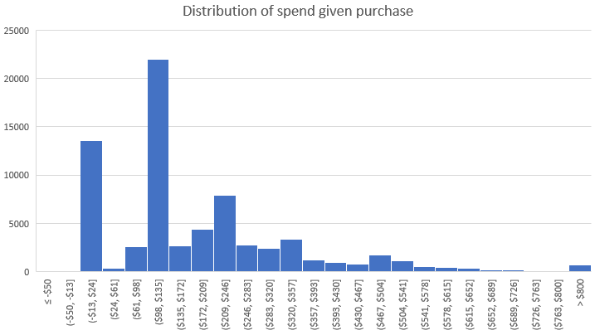
4. Distribution of spend per purchase in Excel
What does this tell us?

Slide 24
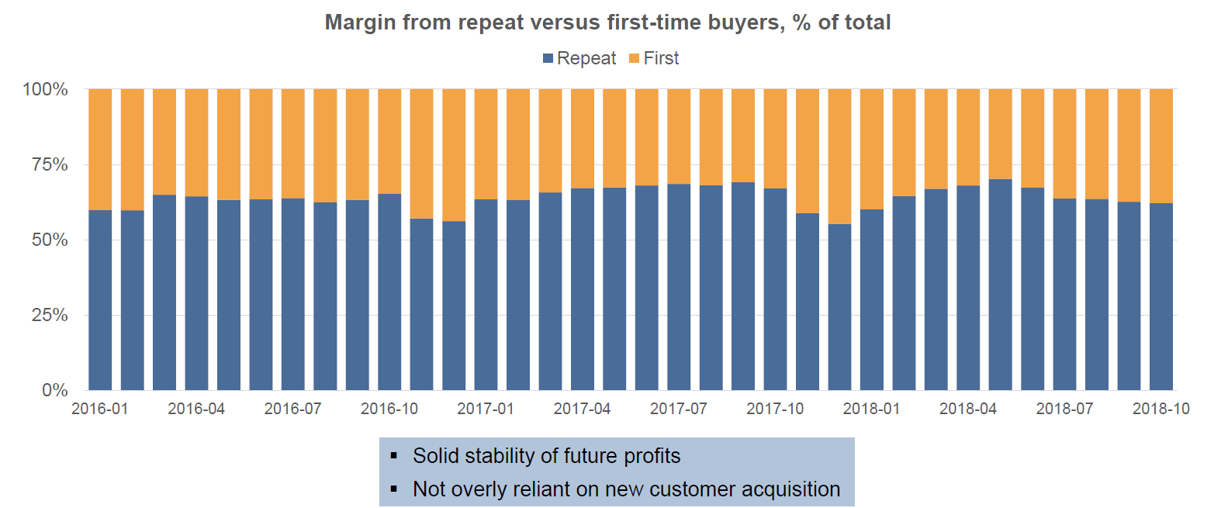
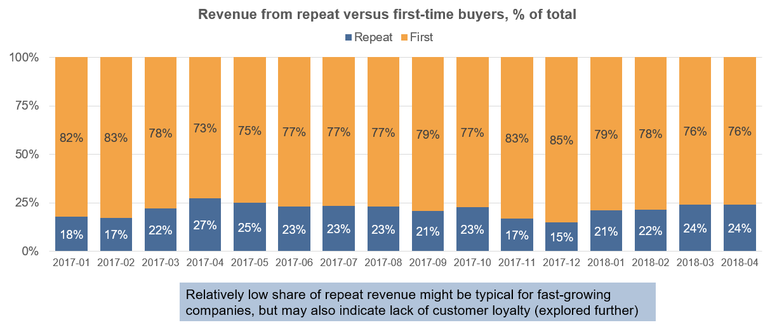
5. Initial versus repeat sales
What: total spend from repeat buyers versus initial buyers over time
Why: sales from repeat customers generally “stickier” and higher margin
Recent diligence:
Another:

Slide 25
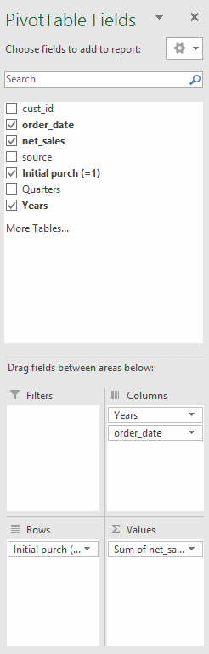
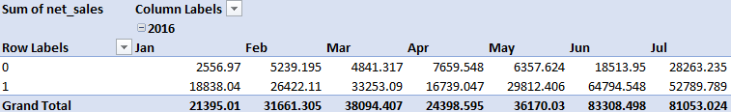
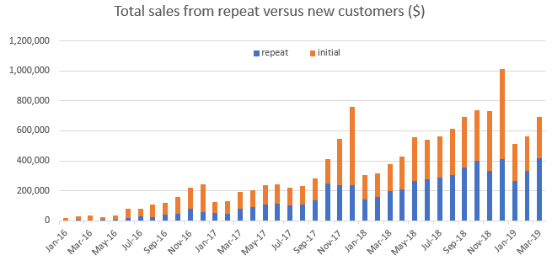
5. Initial versus repeat sales in Excel
Rows=initial_ind,cols=months,
cells = sum(sales)

Slide 26
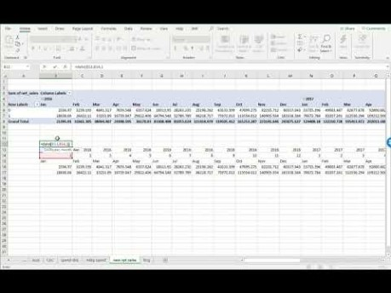
5. Initial versus repeat sales in Excel
Plotting sales from new versus repeat customers ($’s):

Slide 27
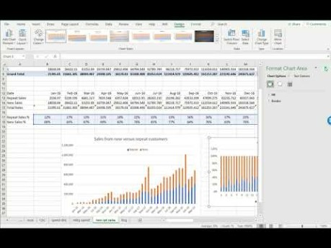
5. Initial versus repeat sales in Excel
Plotting sales from new versus repeat customers (% of total sales):

Slide 28
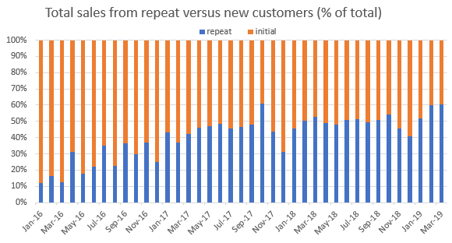
5. Initial versus repeat sales in Excel
What does this tell us?

Slide 29
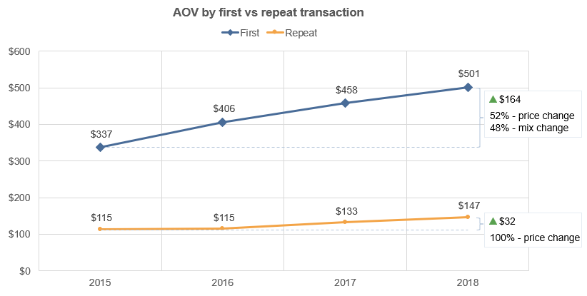
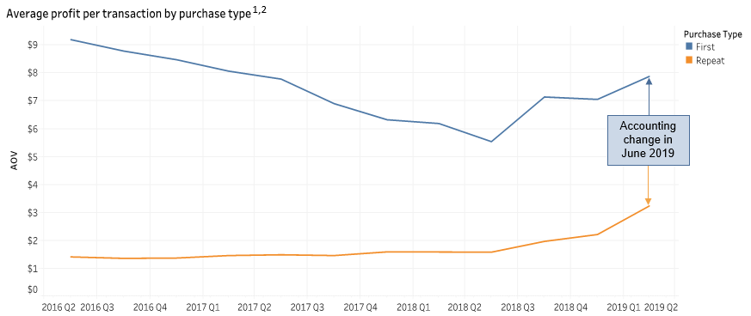
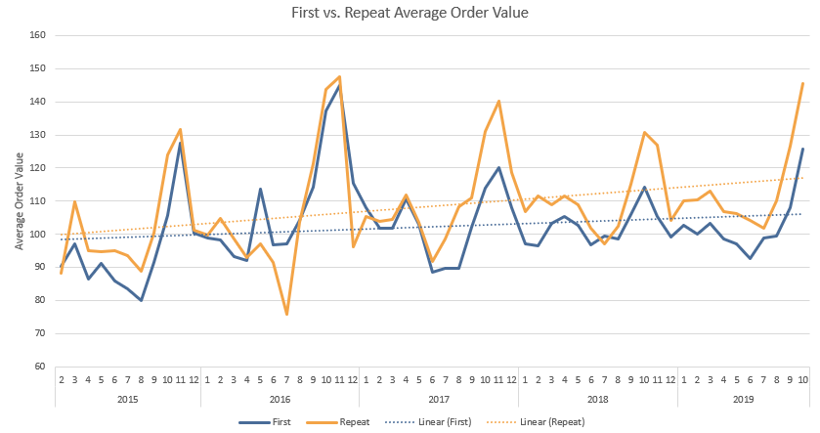
6. Initial versus repeat AOV
What: average spend per purchase on initial purchase vs all repeat purchases
Why: significant differences initial and repeat spends!
Recent diligence:
Another:
And another:

Slide 30
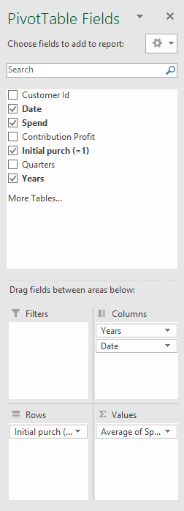
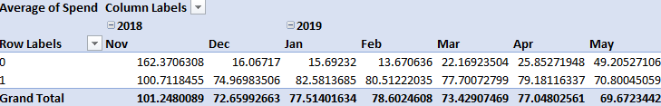
6. Initial versus repeat AOV in Excel
Rows=initial_ind, cols=months,cells=avg(spend)

Slide 31
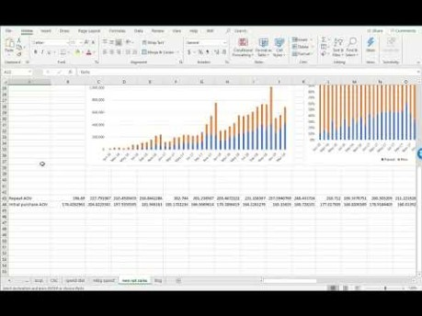
6. Initial versus repeat AOV in Excel
Notes:
Initial sales used to be larger, but now, not much trend.

Slide 32
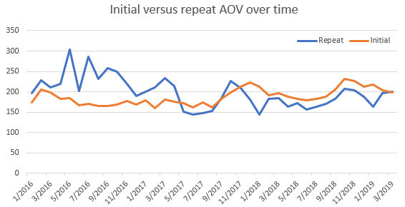
6. Initial versus repeat AOV in Excel
What does this tell us?

Slide 33
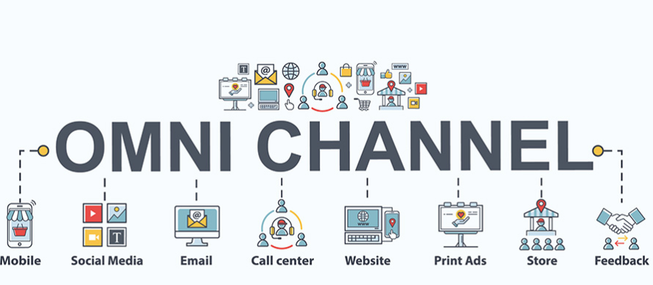
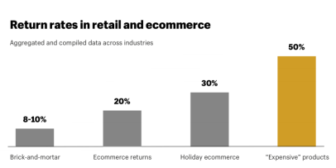
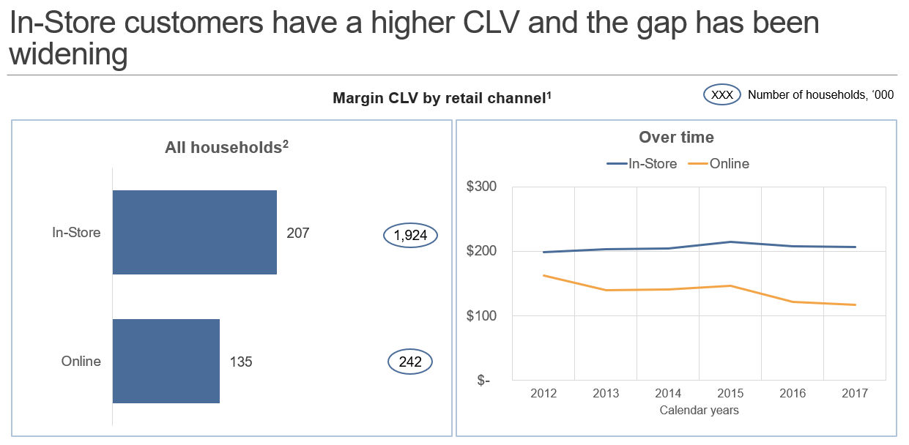
7. Sales and AOV by source
What: total sales and AOV by source of order (e.g., online versus in-store)
Why: profitability and unit economics may differ significantly by channel
Recent diligence:

Slide 34
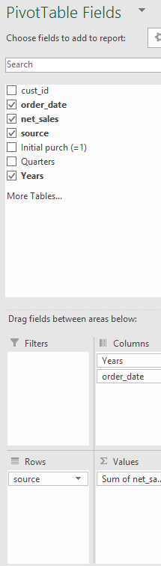
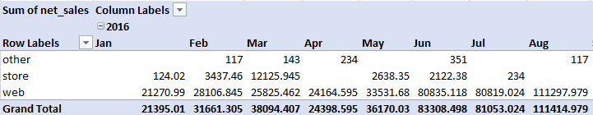
7. Sales by source in Excel
Rows=source, cols=birthmonth, cells=sum(spend)
[ Exactly the same process as with AOV for new versus repeat purchases ]

Slide 35
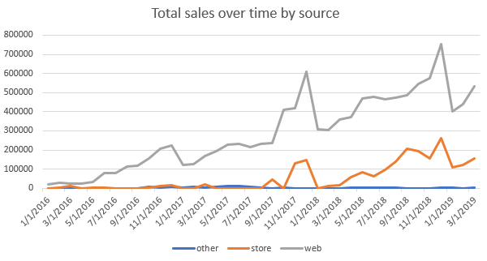
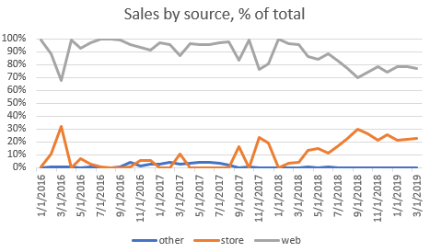
7. Sales by source in Excel
What does this tell us?

Slide 36

7. AOV by source in Excel
Same process, but average(spend):

Slide 37

7. AOV by source in Excel
What does this tell us?

Slide 38

8. First purchase profitability
What: average variable profit from initial purchase, minus CAC
Why: If profitable, everything else is “icing on the cake”
Measure of how much CLV depends on repeat purchasing (risk)
Artem’s startup story…
Revolve Clothing (S-1):

Slide 39


8. First purchase profitability
First, we need transaction-level contribution profitability
What to include:
Direct labor and materials (COGS)
Handling of inventory
Fulfillment
Merchant processing fees
All return-related expenses (shipping, re-stocking)
[Indirect effectively variable expenses]
If available at transaction level:
Everything else:

Slide 40



8. First purchase profitability in Excel
Rows=initial_ind, cols=months, cells=avg(contribution profit)
Subtract CAC by cohort from initial profit:

Slide 41

8. First purchase profitability in Excel

Slide 42


8. First purchase profitability in Excel
What does this tell us?

Slide 43


9. Cohorted revenue (the “C3”)
What: total revenues, broken down by acquisition cohort, over time
Why: (exceedingly rich) one-chart summary of growth, acquisition, and retention
Slack (S-1):
Dropbox (S-1):
For more on the virtues of the C3, read this

Slide 44





9. Cohorted revenue (the “C3”) in Excel
Get everyone’s “birthday”: filter to initial_ind=1, rows=cust_ids, cells=date
vlookup → transaction log
Pivot:
rows = birthmonths cols = months
cells = sum(spend)

Slide 45
9. Cohorted revenue (the “C3”) in Excel

Slide 46

9. Cohorted revenue (the “C3”) in Excel
The resulting C3:
Notes:
Highlight how much of sales are coming from repeaters

Slide 47

10. Cohorted revenue retention curve
What: average monthly revenue over customer lifetime as a % of initial revenue
Why: measure of how well a firm is developing customers over time
“The importance of business fundamentals” (Nov 2019):

Slide 48



10. Cohorted revenue retention curve in Excel (1/2)
Pivot for sales by customer tenure: rows=birthmonth, cols=tenure, cells=sum(sales)
Get number of days, then months (rounded up), from customer acquisition that purchase occurred:

Slide 49

10. Cohorted revenue retention curve in Excel (2/2)
Convert spend by customer tenure to spend by tenure as a % of initial spend:

Slide 50

10. Cohorted revenue retention curve in Excel

Slide 51

10. Cohorted revenue retention curve in Excel (2/2)
How to interpret this?

Slide 52

11. Cohorted cumulative spend per customer in Excel
Use spend by customer tenure and monthly customers acquired to get cumulative spend per customer:

Slide 53

11. Cohorted cumulative spend per customer in Excel

Slide 54

11. Cohorted cumulative spend per customer in Excel
What does this tell us?

Slide 55

12. Customer spend distribution
What: for a given cohort, distribution of total spend by customer
Why: measure of how much revenue coming from best vs everyone else
Proxy for the E(PAV) distribution

Slide 56


12. Customer spend distribution in Excel
Get (1) total spend (2) for each customer (3) within the cohorts of interest. Filter on birthmonth, rows=cust_id,cols=sum(sales)

Slide 57

12. Customer spend distribution in Excel

Slide 58

12. Customer spend distribution in Excel
What does this tell us?

Slide 59

13. Pareto Curve for sales
What: for a given cohort, get the % of revenues coming from the top x% of your customers
Why: very important summary of customer sales concentration (similar to (12))

Slide 60


13. Pareto Curve for sales in Excel
Use same spend by customer data from (9). Get the rank of each customer (breaking ties!)
Get percentile of customer from rank, then round up to nearest 10th
( 99% → 100%, 91% → 100%, 89% → 90%, …)
Get total spend within each resulting spending decile, convert to a cumulative sum, then express as a % of total revenue

Slide 61

13. Pareto Curve for sales in Excel

Slide 62

13. Pareto Curve for sales in Excel
The resulting chart:
What does this suggest?

Slide 63
Key takeaways
Transaction log: a gold mine, but need to know how to mine it
Pivot Tables are your friend! (And offset())
Need to understand variation in sales and profit across:
Purchases
Customers
Sources/channels
Calendar Time
Tenure

Slide 64
Additional reading
“Cohort analysis – 4 ways to analyze your product retention rate” (link)
“23 Tactics That Will Flatten Your Retention Curve and Get Users To Stick Around” (link)
McCarthy, Daniel; Winer, Russell (2019): “The Pareto Rule in Marketing Revisited: Is it 80/20, or 70/20?”. Marketing Letters (link)

